Slide 1
TGA Hemodynamics
Dr.Rakesh.K
SR Cardiology

Slide 2
Introduction
Transposition: aorta from morphologic RV and pulmonary artery from morphologic LV.
Atrio-ventricular concordance with ventriculo-arterial discordance
Two circulations in parallel →CCHD
Spatial relationship of the great arteries also abnormal

Slide 3
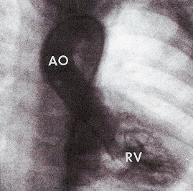
LV ANGIO
AO→RV→RA→LA→LV
RV ANGIO
AO→RV

Slide 4
Morphogenesis
Abnormal growth of subaortic infundibulam and absence of subpulmonary infundibulam.
Pulmonary- mitral continuity +.
Aorto-tricuspid discontinuity seen.
Aorta- anterior, cephaloid & right
Coronaries arise from two aortic sinuses adjacent to the aortico-pulmonary septum.
Non coronary sinus of aorta most anterior.
SA node artery- surgical importance in TGA

Slide 5
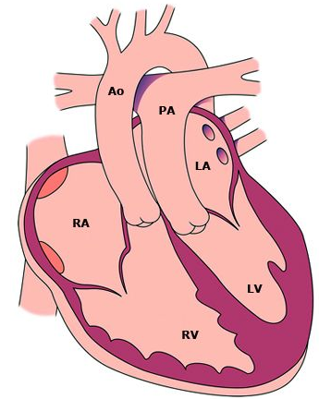

Slide 6
Co-existing anomalies
VSD- 40-45% (Conovenrticular-33% Muscular-27%)
LVOTO-10% (Dynamic /Fixed)
PDA
TV (4%) or MV (20%) anomalies
Coronary anomalies (35%- MC- LCX from RCA)
COA or aortic arch anomalies(5%)
Juxtaposition of atrial appendages(2-5%)
Notes:
Simple and complex D-TGA
About 50% are Complex D-TGA

Slide 7
Physiology
Systemic and pulmonary circulations are parallel circuits
This circulation is incompatible with life unless there is communication between the two parallel circuits
Mixing can be either intracardiac or via extracardiac connections
Notes:
D-TGA prior to surgical repair is physiologically uncorrected, which means that the systemic and pulmonary circulations are parallel circuits. Deoxygenated systemic venous blood drains appropriately into the right atrium and then is pumped from the right ventricle back to the systemic circulation via the aorta. Oxygenated pulmonary venous blood returns to the left atrium and ventricle, and is then recirculated to the lungs via the pulmonary artery
This circulation is incompatible with life unless there is communication between the two parallel circuits. Mixing can occur either intracardiac across a patent foramen ovale or a ventricular or atrial septal defect (VSD or ASD), or via extracardiac connections including a patent ductus arteriosus (PDA) or the bronchopulmonary collateral circulation.

Slide 9
Hemodynamics
The lesions that commonly affect the hemodynamic and clinical features are,
Ventricular septal defect,
Pulmonary stenosis,
Atrial septal defect.
The size of the defects and severity of the stenosis are important in determining the manifestations.

Slide 10
Physiologic-Clinical classification which have hemodynamic significance
TGA (IVS or small VSD) with ↑PBF and small ICS.
TGA (large VSD) with ↑PBF and ↑ ICS.
TGA {VSD and LVOTO( or PS)} with restricted PBF.
TGA (VSD and PVOD) with restricted PBF.
ICS – inter circulatory shunting
PVOD-pulmonary vascular obstructive disease

Slide 11
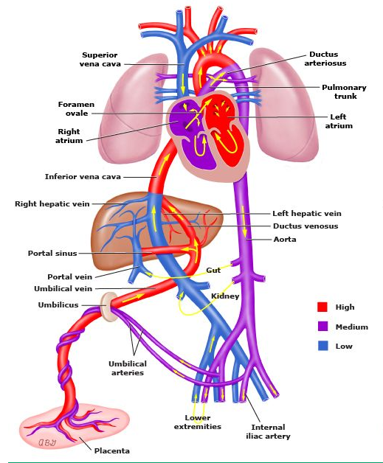
Fetal physiology
Notes:
Brain and heart — Blood flowing through the coronary and carotid arteries has a high degree of oxygen saturation because oxygenated blood from the umbilical vein flows to the right atrium (via the ductus venosus and inferior vena cava) and is shunted through the foramen ovale to the left side of the heart and aorta. This shunting is achieved through differential velocities of incoming venous blood streams and directing of oxygenated blood to the foramen ovale. This reduces mixing of oxygenated blood with deoxygenated blood entering the right atrium from the superior vena cava. The deoxygenated blood is directed toward the right ventricle and shunted through the ductus arteriosus to the aorta but distal to the origin of the carotid and coronary arteries.
Aortopulmonary transposition is compatible with fetal survival and normal body growth and development. There is no evidence that there is a significantly high incidence of aortopulmonary transposition in stillbirths. The gestational development of the fetus also appears to be normal in most cases; in fact, there is a tendency for these infants to be rather large and heavy at birth. This relatively normal development of the fetus is related to the presence of the foramen ovale and the ductus arteriosus.

Slide 12
Normal Fetal physiology
Notes:
Brain and heart — Blood flowing through the coronary and carotid arteries has a high degree of oxygen saturation because oxygenated blood from the umbilical vein flows to the right atrium (via the ductus venosus and inferior vena cava) and is shunted through the foramen ovale to the left side of the heart and aorta. This shunting is achieved through differential velocities of incoming venous blood streams and directing of oxygenated blood to the foramen ovale. This reduces mixing of oxygenated blood with deoxygenated blood entering the right atrium from the superior vena cava. The deoxygenated blood is directed toward the right ventricle and shunted through the ductus arteriosus to the aorta but distal to the origin of the carotid and coronary arteries.
Aortopulmonary transposition is compatible with fetal survival and normal body growth and development. There is no evidence that there is a significantly high incidence of aortopulmonary transposition in stillbirths. The gestational development of the fetus also appears to be normal in most cases; in fact, there is a tendency for these infants to be rather large and heavy at birth. This relatively normal development of the fetus is related to the presence of the foramen ovale and the ductus arteriosus.

Slide 13
Fetal circulation in TGA
Notes:
The vascular resistance provided by the placenta is lower than the pulmonary capillary bed, which allows for right-to-left blood flow through the ductus arteriosus (DA) and into the descending aorta. However, one potential fetal problem is the normal flow of oxygen rich blood towards the head and neck vessels is disrupted by the inability to pump the oxygenated blood directly into the ascending aorta from the left ventricle
Pulmonary arterial oxygen saturation is considerably greater than normal. The aorta arises from the right ventricle and oxygen saturation in the ascending aorta is less than normal. Descending aortic blood oxygen saturation is similar to that in the normal fetus.
The pulmonary vascular resistance, which is very sensitive to small changes in Po2, will be considerably lower than normal and thus pulmonary blood flow will be higher than normal. In the fetus, oxygen consumption of the lung is very low, so the pulmonary venous blood has a relatively high oxygen saturation and this facilitates maintenance of a very high oxygen saturation of left atrial and left ventricular blood.

Slide 14
TGA with VSD in Fetus
Shunt depend on afterload
Bidirectional shunting can occur
RV to LV during systole
LV to RV during diastole
Notes:
Depending on the afterload on each ventricle, some shunting could occur in either direction, and it is possible that bidirectional shunting could occur. The high oxygen saturation of pulmonary arterial blood will decrease pulmonary vascular resistance, and during systole blood will probably shunt from the right to the left ventricle. This will result in some decrease in Po2 of blood distributed to the lungs as well as through the ductus arteriosus. During diastole, a large volume will return from the pulmonary veins to the left atrium and ventricle and thus a shunt from the left to the right ventricle is likely to occur.

Slide 15
TGA with VSD and PS in fetus
If PS is severe, complete admixture of LV & RV blood occurs through large VSD.
Po2 of ascending aorta, descending aorta & PA will be almost same.
Pulmonary circulation is through DA from Aorta.
Equal pressures in RV & LV.
Less reduction in PVR.

Slide 16
Difference between fetal circulation in normal vs TGA
PA-SPO2 greater than normal
PVR -less than normal
Increased PBF
Increased LA & LV pressure
Restricted FO +/-
Ductus constriction +/-
Increased PA pressure
Increased PV Smooth muscle development
PPHTN of the newborn +/-

Slide 17
Postnatal physiology of TGA
Notes:
Once the infant is born, the stability of the child will be largely determined based on the degree of mixing that occurs between the two parallel circulations. For viability, some degree of oxygenated pulmonary venous return must make its way to the systemic capillary bed (effective systemic blood flow), while a similar degree of systemic venous return must enter the pulmonary capillary system (effective pulmonary blood flow). Oxygen saturations and the degree of hypoxemia are largely based on the amount of intercirculatory mixing that occurs through the intracardiac and extracardiac connections. The goal of optimizing intercirculatory mixing is achieved by balancing the effective pulmonary and systemic blood flows. This mixing occurs most efficiently at the level of the atria as lower pressure differences allow for bidirectional flow across the atrial septum; flow can occur in both systole and diastole. Intracardiac (eg, VSDs) and extracardiac (eg, PDAs) mixing at other sites is more limited, due to the presence of larger pressure gradients, which typically direct blood in only one direction. Shunting of blood preferentially towards either the systemic or pulmonary circulation tend to results in clinical deterioration.
It is essential that there be some means for systemic venous blood to enter the pulmonary circulation to be oxygenated and also for pulmonary venous blood to pass into the systemic arterial system to supply oxygen to the tissues. This bidirectional shunting after birth may occur through persistent patency of fetal channels, the foramen ovale and the ductus arteriosus, or through abnormal channels, such as ventricular or atrial septal defects.
A left-to-right shunt represents the volume of blood passing from the left atrium or ventricle, or the aorta, directly into the right side of the heart. In most congenital cardiac lesions, it reflects the volume of pulmonary venous or oxygenated blood that recirculates through the lungs. However, in aortopulmonary transposition the pulmonary venous blood shunted from the left to the right side of the heart enters the systemic circulation and does not recirculate to the lungs. The pulmonary venous blood returning to the left atrium and ventricle that is not shunted is ejected into the pulmonary artery and does recirculate.
To avoid confusion, it is convenient to introduce the concept of anatomical and physiological shunting

Slide 18
Transitional Circulation
PVR fall and SVR increases
RA Pr won’t come down as compared to normal baby
Bidirectional flow at foramen ovale
In TGA with IVS, the DA is widely patent after birth
Early after birth, ductal flow is bidirectional
With fall in PVR, shunt at the PDA is from aorta to PA with an equal amount of blood passing from the pulmonary to systemic circuit at the atrial level
Rarely, there is a delayed fall in PVR that results PPHTN
Notes:
After birth, the pulmonary vascular resistance falls with expansion of the lungs and pulmonary blood flow and left atrial pressures increase in accordance with the more or less normal neonatal transitional physiology. The systemic vascular resistance increases because of removal of the low-resistance placental circulation. In the normal neonate, the right atrial pressure falls as the right side of the heart faces the rapidly decreasing pulmonary vascular resistance and the interatrial pressure difference favors closure of the septum primum flap over the foramen ovale. With TGA, however, the right atrial pressures are increased, and the similarity of atrial pressures tends to keep the foramen ovale open (incompetent valve), with resulting bidirectional shunting
In TGA with IVS, the ductus arteriosus is often widely patent after birth. Early after birth, when pulmonary vascular resistance is still high, there is bidirectional ductal flow: in systole, left ventricle, pulmonary artery, ductus, descending aorta; and in diastole, aorta, ductus and pulmonary artery. With continued fall in pulmonary vascular resistance, the shunt at the PDA is primarily from aorta to pulmonary artery (effective pulmonary blood flow), with an equal amount of blood passing from the pulmonary circuit to systemic circuit at the atrial level (effective systemic blood flow).
Rarely, there is a delayed fall in pulmonary vascular resistance that results in persistent pulmonary hypertension, little ductal shunting, and limited intercirculatory mixing. Urgent balloon septostomy or even surgical septectomy will not improve the severe hypoxemia, and these neonates may need urgent support with early repair or extracorporeal membrane oxygenation. Finally, severe hypoxemia in some neonates may be due to an intact or virtually intact atrial septum.
Despite a widely patent ductus arteriosus (PDA), there is poor intercirculatory mixing at this site alone; the primarily aorta-pulmonary artery shunting cannot be balanced by an equal volume of shunting from left atrium to right atrium. These neonates are typically severely hypoxemic and acidotic shortly after birth, may have severe pulmonary edema and hemorrhage, and may not survive if septostomy or arterial repair cannot be accomplished in a timely fashion.

Slide 19
Early development of PVOD in TGA patients (Heath-Edwards III and more).
It is very early in TGA with VSD(78% by 12 months) and seen in TGA-IVS also( 34% by 12 months).
Reason multi-factorial
Increased PV muscularity
Increased intimal hyperplasia
Decreased intra-acinar pulmonary arteries
Pre-capillary pulmonary arteriolar-bronchial arterial anastomosis
Regional pulmonary hypoxemia
Overall increased flow rate
Increased pulmonary vascular shear stress
Endothelial damage
Platelet activation
Microthrombi formation

Slide 20
Definition of shunts- Physiological shunts
Left to right: The volume of oxygenated pulmonary venous return re-circulated to pulmonary circulation (Qp – Qep)
Right to left: volume of systemic venous blood that re-enters the systemic arteries without passing through the lung (Qs – Qes)

Slide 21
Anatomical shunts
Left to Right: Blood flowing from left sided chambers to the right sided chambers.
It is always more than effective systemic flow due to bidirectional shunt.
Right to Left: Blood flowing from right sided chambers to the left sided chambers
It is always more than effective pulmonary flow due to bidirectional shunt.

Slide 22
Effective pulmonary blood flow (Qep)
The volume of systemic venous return that is effectively oxygenated in the lungs
Effective systemic blood flow (Qes)
The volume of oxygenated pulmonary venous return that enters the systemic circulation and perfuses the systemic capillary bed

Slide 23
Inter-circulatory shunting
Systemic venous return
Pulmonary venous return
Anat R-L
Anat L-R
RIGHT
HEART
LEFT
HEART
Physio R-L
Physio L-R
Q es
Q ep
Body
Lungs
QS
QP
Notes:
The net volume of blood passing from the pulmonary circulation (left atrium, left ventricle, pulmonary arteries) to the systemic circulation (right atrium, right ventricle, aorta) represents the anatomic left-to-right shunt and is, in fact, the effective systemic blood flow (i.e., oxygenated pulmonary venous return perfusing the systemic capillary bed). Conversely, the net volume of blood passing from the systemic circulation to the pulmonary circulation represents the anatomic right-to-left shunt and is, in fact, the effective pulmonary blood flow (systemic venous return perfusing the pulmonary capillary bed). The effective pulmonary blood flow, effective systemic blood flow, and net anatomic right-to-left and net anatomic left-to-right shunts are each equal to each other, and this volume is the intercirculatory mixing.

Slide 24
Bidirectional shunting and recirculation of anatomical shunt

Slide 25
Inter-circulatory mixing/shunting
The effective PBF, effective SBF are each equal.
That means the net anatomic R→L and net anatomic L→R shunts are also equal to each other.
This volume is the inter-circulatory mixing & it depend on.
Anatomic communication –Number, Size &Position.
Total blood flow through the pulmonary circuit
LVOTO
PS
PVOD
Local pressure gradient
Respiratory cycle phase

Slide 26
Unique feature of TGA
In most CCHD the PBF will reflect the systemic arterial saturation…e.g TOF physiology
In TGA even if the PBF is high can have very low systemic arterial saturation.
It is the effective PBF that determine the SpO2.
But the LV dynamics & PVR doesn’t depend on Qep, it depend on the Qp.

Slide 27
Survival depends on inter- circulatory shunting (ICS) volume.
↑ ICS volume → ↑ PBF→ Improve SpO2
But at same time lead to ↑ chance of
PVOD
LV remodeling→ LVOTO
LV volume over load→LVF
If VSD alone, the flow has to be bidirectional
If the flow is only or predominantly left to right across the ASD, it suggests presence of additional shunt (VSD or PDA)
Except in the initial few days, PDA flow is always left to right (Aorta to PA)

Slide 28
Hemodynamic in each types of TGA

Slide 29
TGA with IVS
Decreased PVR
Reduce afterload on LV
Increased Stroke Volume to PA
If DA remains open, aorta → PA flow.
Quantity of flow depend on size of ductus and PA, aortic pressure or relative resistance if the systemic & pulmonary circulation.
Gradually the LA pressure ↑→ Pulmonary odema
↑LA pr→ ↑ Pul. Venous pr > systemic venous pr → open up flow through bronchial veins→ azygous vein /or stretch open the foramen ovale.
Notes:
In the presence of aortopulmonary transposition, the right ventricle, which ejects into the aorta, is confronted
a greater afterload and initially its stroke volume will fall. End-diastolic volume and pressure will be elevated to raise stroke volume and the right atrial a wave will increase. The decrease in pulmonary vascular resistance associated with ventilation will reduce the afterload on the left ventricle, allowing a greater stroke volume into the pulmonary artery. If the ductus arteriosus remains open, the fetal flow pattern will be reversed and blood will flow from the aorta to the pulmonary artery, the quantity of flow being determined by the size of the ductus and the pulmonary arterial and aortic pressures.
If the ductus is widely patent and pulmonary arterial and aortic pressures are the same, the flow will be determined by relative resistance in the pulmonary and systemic circulations. In the early postnatal period, while pulmonary vascular resistance is still relatively high, pulmonary blood flow as well as the ductus shunt are not very large, but with further maturation of the pulmonary vasculature, an increasing pulmonary blood flow will develop.

Slide 30
TGA with small VSD
Hemodynamic is similar to DA dependent circulation.
Early postnatal period (PVR high) → only a small shunt from RV to LV.
When PVR fall → Increased RV to LV shunt, increased LA and LVDP.
LA to RA flow is necessary for bidirectional shunting.
If inter atrial flow is limited, LA and PV pressure rises and lead to pulmonary edema
Decrease in VSD size over time → fall in arterial SPO2
VSD of moderate size may permit somewhat greater bidirectional mixing, with less hypoxemia.
Notes:
In the early postnatal period, while PVR is still elevated, only a small shunt will occur from the right to the left ventricle.
As pulmonary vascular resistance falls, right-to-left ventricular shunting will increase, raising pulmonary blood flow and left atrial as well as left ventricular diastolic pressure. Left-to-right atrial flow of blood is necessary to establish bidirectional shunting. Although some left-to-right ventricular shunt will develop as left ventricular diastolic pressure increases, it is limited because at the low pressures in diastole, only a small shunt will occur through the small defect. As described above for the ductus arteriosus, if the foramen ovale does not permit adequate flow from the left to the right atrium, left atrial and pulmonary venous pressures will increase and pulmonary edema may develop. The tendency is for the size of the ventricular septal defect to decrease over time, and this will result in a fall in arterial oxygen saturation.
A ventricular septal defect of moderate size may permit somewhat greater bidirectional mixing, with less hypoxemia. A spectrum thus exists between the infants with very small or insignificant ventricular septal defects and those with very large ventricular defects.

Slide 31
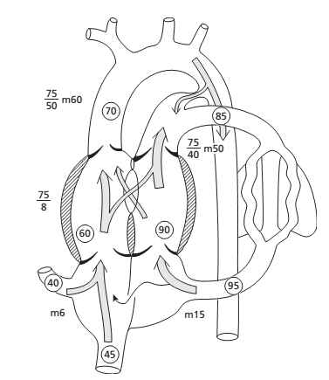
TGA with Large VSD
Only minimal systemic arterial hypoxemia
CCF develop within 2 to 6 week
Development of CCF depend on relationship of PVR and SVR
Progressive increase in pulmonary vascular resistance
PVOD develop much earlier than isolated VSD
Notes:
When a large VSD is present, shunting between the pulmonary and systemic circulation may be so effective that only minimal systemic arterial hypoxemia occurs, but severe cardiac failure is often encountered. The development of cardiac failure is primarily dependent on the relationship of pulmonary and systemic vascular resistances.
The presence of a large ventricular septal defect will maintain left ventricular and pulmonary arterial systolic pressures at systemic levels. This will delay the postnatal fall in pulmonary vascular resistance and the child will be subject to the risk of developing a subsequent increase in pulmonary vascular resistance with permanent pulmonary vascular obstructive changes. The increase in pulmonary vascular resistance causes a decrease in pulmonary blood flow and relief from cardiac failure but also a decrease in arterial oxygen saturation.
Progressive increase in pulmonary vascular resistance usually develops at a much younger age than in individuals with ventricular septal defect alone. Not infrequently, pulmonary vascular changes are already present by 3– 4 months of age and significant changes are almost always present by 1 year of age. The reason for the earlier onset of pulmonary vascular obstruction in infants with transposition and a large ventricular septal defect is not known. One possible explanation is that the main pulmonary artery is short and the kinetic forces of left ventricular ejection may be more readily transmitted to the peripheral vessels, creating greater shear forces.

Slide 32
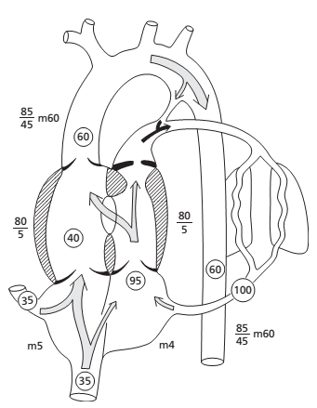
TGA with Severe PS
VSD is usually non restrictive
Adequate PBF is necessary to maintain a good systemic saturation.
PBF has to be provided by a communication from the aorta to the PA beyond the stenosis
Cardiac failure rare
TOF physiology
If pulmonary flow and bronchial flow are adequate to prevent severe hypoxemia, these patients may tolerate the lesion well and may survive for many years without treatment
Notes:
Cardiac enlargement is not usually present and cardiac failure does not usually occur. If pulmonary flow and bronchial flow are adequate to prevent severe hypoxemia, these patients may tolerate the lesion well and may survive for many years without treatment

Slide 33
Factors influencing systemic saturation
Extent of inter-circulatory mixing and Total PBF
High PBF results in increased oxygenated blood available in the left sided chambers for mixing: higher systemic SO2 if there is good mixing
Reduced PBF will result in low systemic SO2 in spite of adequate anatomic shunts

Slide 34
Factors influencing systemic saturation
If there is delay in the fall of PVR (PPHN), hypoxemia will persist despite adequate ASD and
Need ECMO or urgent ASO
Hypoxemia provokes a fall in SVR and increase the recirculating systemic volume
Fall in SVR may deplete the pulmonary circulation further

Slide 35
Role of broncho-pulmonary collaterals
Broncho-pulmonary anastomotic channels have been visualized by angiography in >30% of infants with TGA (<2year)
Systemic arterial hypoxemia may stimulate development of bronchpulmonary collaterals
Usually in TGA with solely a restrictive inter-atrial communication
Prolonged survival of such infants may be due to this extra-cardiac site of shunting/mixing
Bronchial veins are also a source of LA decompression in high pressure situation FO closes .
Notes:
Preoperative transvenous descending aortogram in a neonate with TGA/IVS showing enlarged bronchial arteries (following the right main stem bronchus) to the right lung

Slide 36
Preoperative transvenous descending aortogram in a neonate with TGA/IVS showing enlarged bronchial arteries (following the right main stem bronchus) to the right lung

Slide 37
Example Calculating shunt in TGA
site | Oxygen content (ml/L)
SVC | 70
AORTA | 80
PUMONARY VEIN | 200
PULMONARY ARTERY | 184
Oxygen consumption 120ml/min/m2

Slide 38
Bronchial collateral circulation
Its presence can be demonstrated but not quantified.
If there is little or no bronchial arterial collateral flow, the oxygen saturation and Po2 of the wedge sample will be higher than that of pulmonary arterial blood and similar to that of pulmonary venous blood.
If a large bronchial flow is present, the wedge sample oxygen saturation and Po2 will be lower than in pulmonary arterial blood, and closer to those of aortic blood.

Slide 39
Simple demonstration

Slide 40
SVC | 70
AORTA | 80
PUMONARY VEIN | 200
PULMONARY ARTERY | 184
Pulmonary blood flow (Qp) = Vo2
PV O2 - PA O2
= 120/200-184
Qp= 7.5L/min/m2
Systemic blood flow (Qs) = Vo2
AO O2 - MV O2
= 120/80-70
Qs = 12 L/min/m2

Slide 41
L
site | Oxygen content (ml/L)
SVC | 70
AORTA | 80
PUMONARY VEIN | 200
PULMONARY ARTERY | 184
Effective pulmonary blood flow = Vo2
PV O2- MV O2
= 120/200-70
Qep = 0.9 L/min/m2
Anatomical L→R & R→ L shunt 0.9 L/min/m2
Physiological L→ R shunt = Qp-Qep =6.6L/min/m2
Physiological R→L shunt = Qs-Qes =11.1L/min/m2

Slide 42
Fallacies in application of Fick’s Principle in calculating shunts and flows in TGA
Oxygen consumption is not normal, so assumed values are unreliable.
Arteriovenous oxygen differences may be very small, so magnitudes of errors in calculated values would be very large(TGA with VSD).
Effect / contribution of Bronchopulmonary collaterals to PBF – can result in overestimation(TGA –IVS)

Slide 43
Thank you
Referance
Congenital diseases of the heart : Clinical –physiological consideration. Abraham M Rudolph.
Moss & Adams’ Heart Disease in Infants, Children, and Adolescents, Including the Fetus and Young Adult. Ninth Edition

